Slide 1
SEGMENTATION AND NOISE REDUCTION OF MEDICAL IMAGES

Slide 2
Two Stage Multi-Threshold Otsu Method (TSMO)

Slide 3
TSMO
Optimized Otsu method based on improved thresholding algorithm
reduces the operating time
increases the separability factor in medical image segmentation

Slide 4
ALGORITHM
START
Obtain histogram values of image
Set initial threshold value
Change in Threshold value?
Apply Conventional Otsu
Segment
Compute new Threshold value
Stop

Slide 5
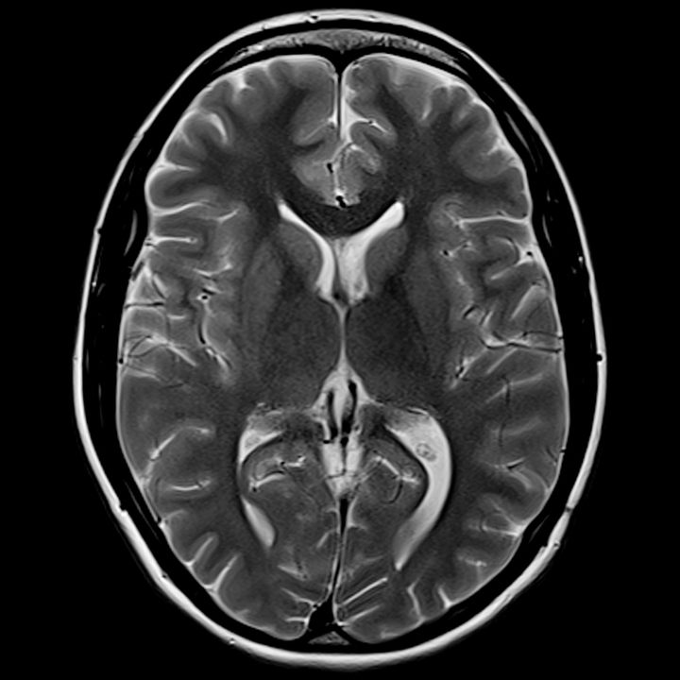
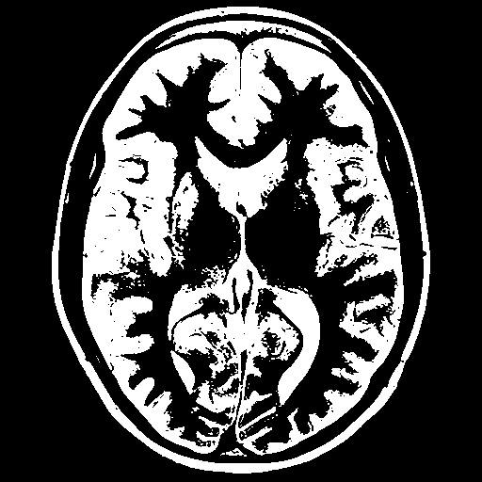
Input image
Output image

Slide 6
Kernelized Fuzzy C – Means (KFCM)

Slide 7
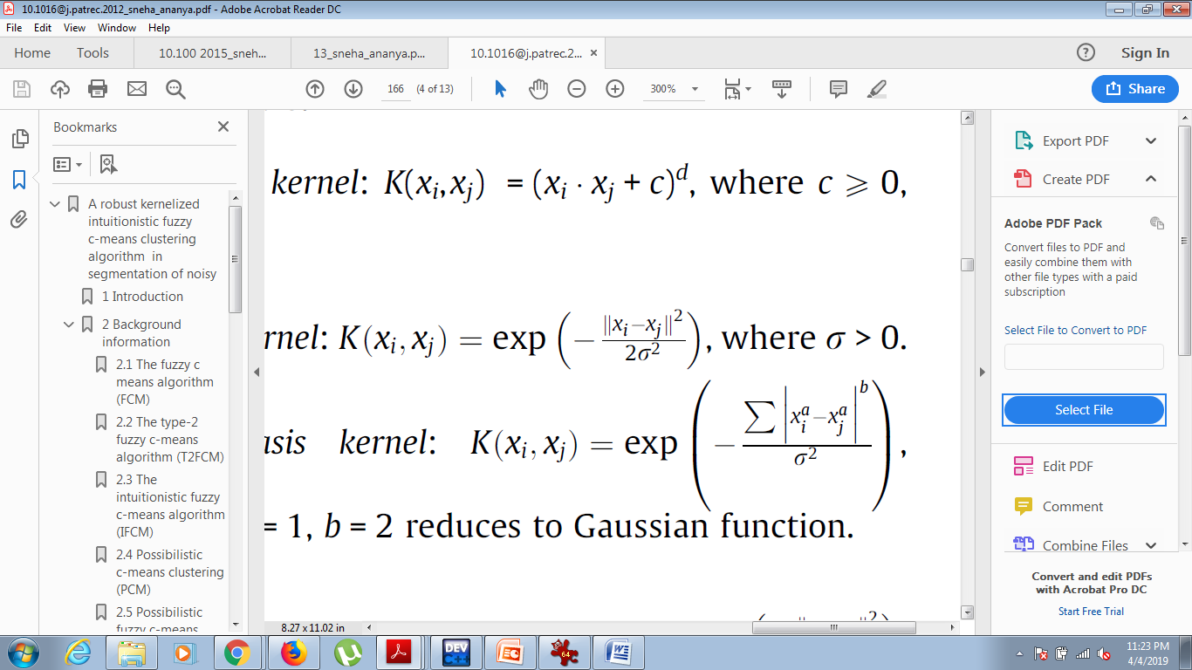
KFCM
Derived from original FCM using ‘kernel’ method
The Euclidean distance is replaced with a kernel induced distance
Gaussian kernel:

Slide 8
ALGORITHM
START
Number of clusters (K)
centroid
Change in clusters?
STOP
Membership value
Compute kernel function

Slide 9
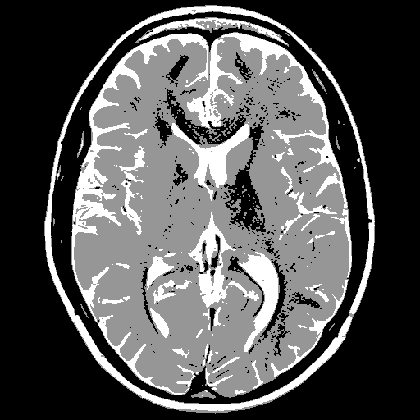
Input image
Output image

Slide 10
modified Fuzzy C – Means (mFCM)

Slide 11
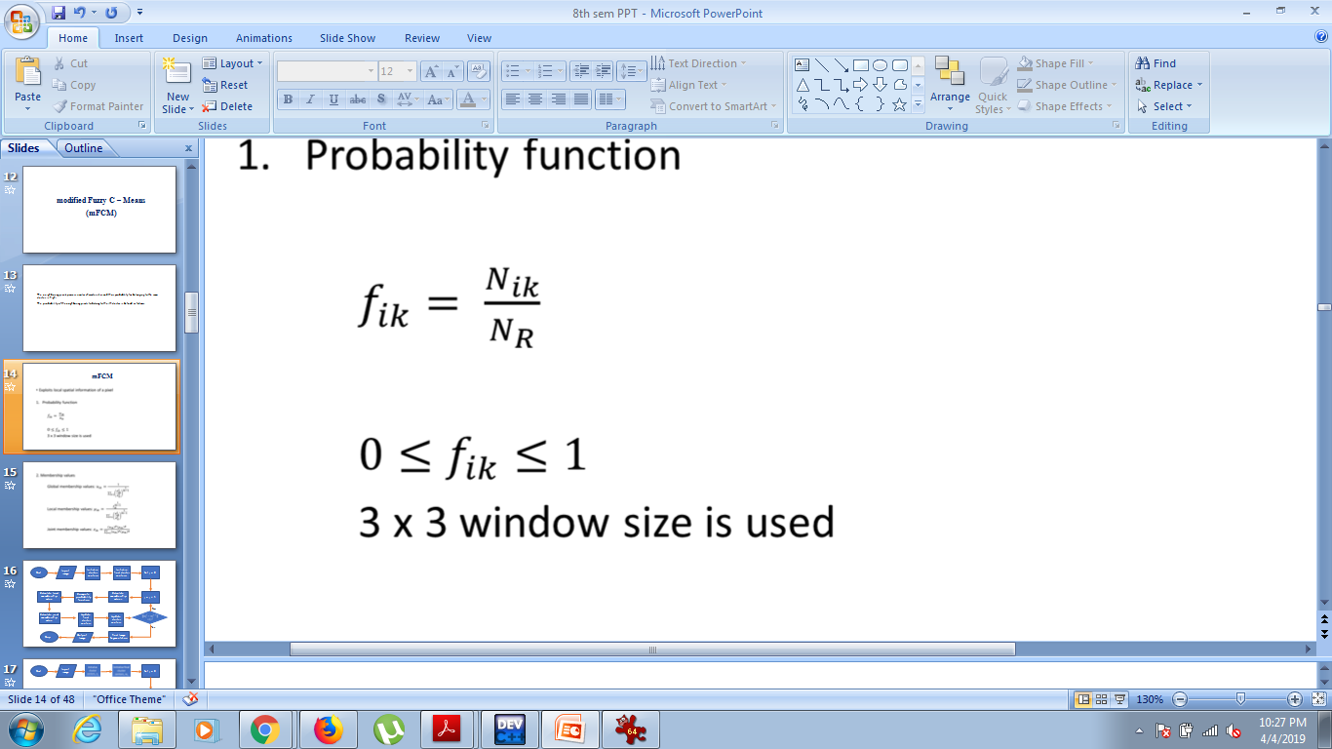
mFCM
The neighboring pixels possess similar characteristics and their probability for belonging to the same cluster is high.
The probability of the neighboring pixels to belong to the ith cluster is defined as follows:
Where,
3 x 3 window size is used

Slide 12
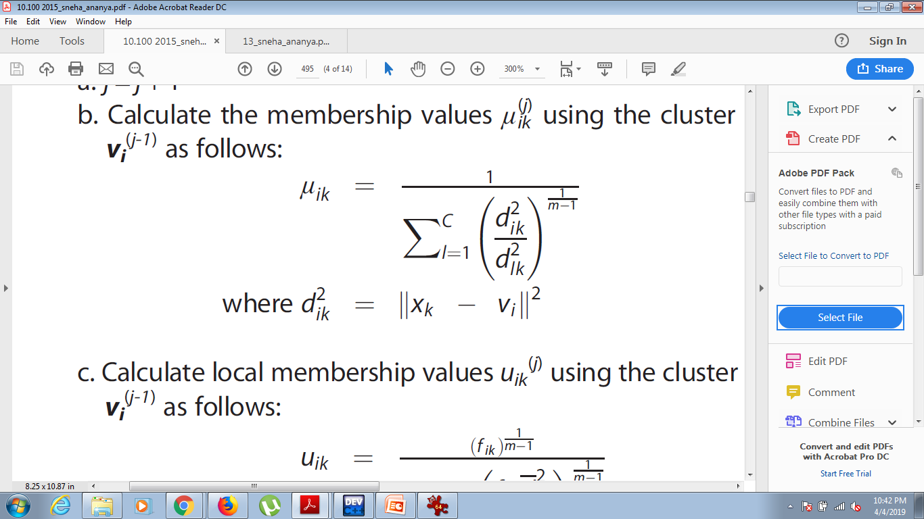
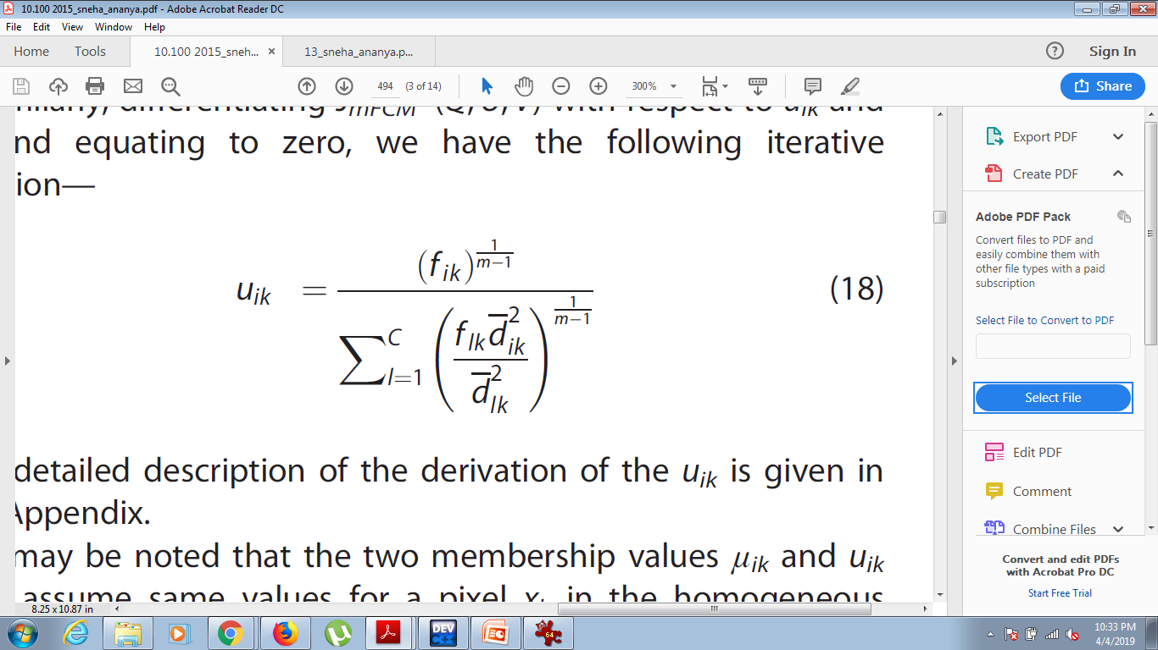
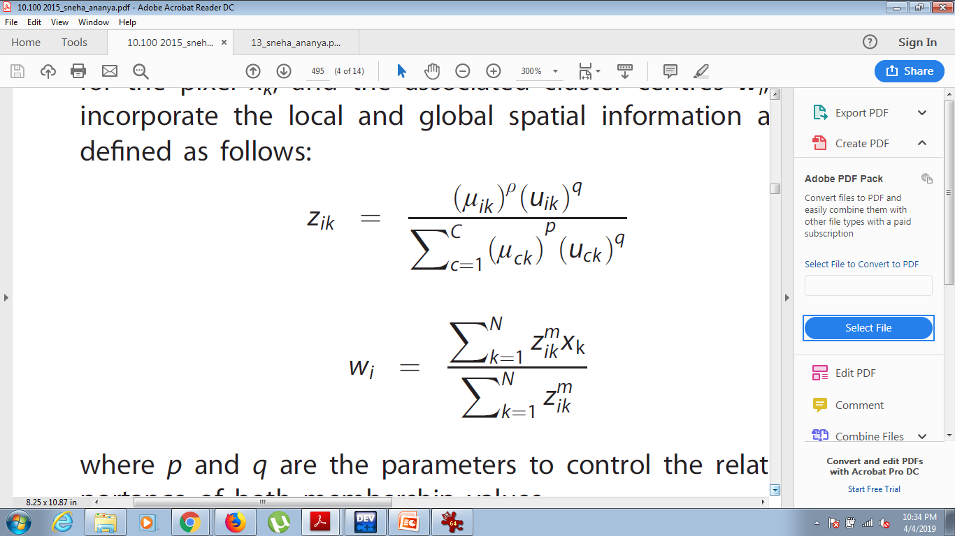
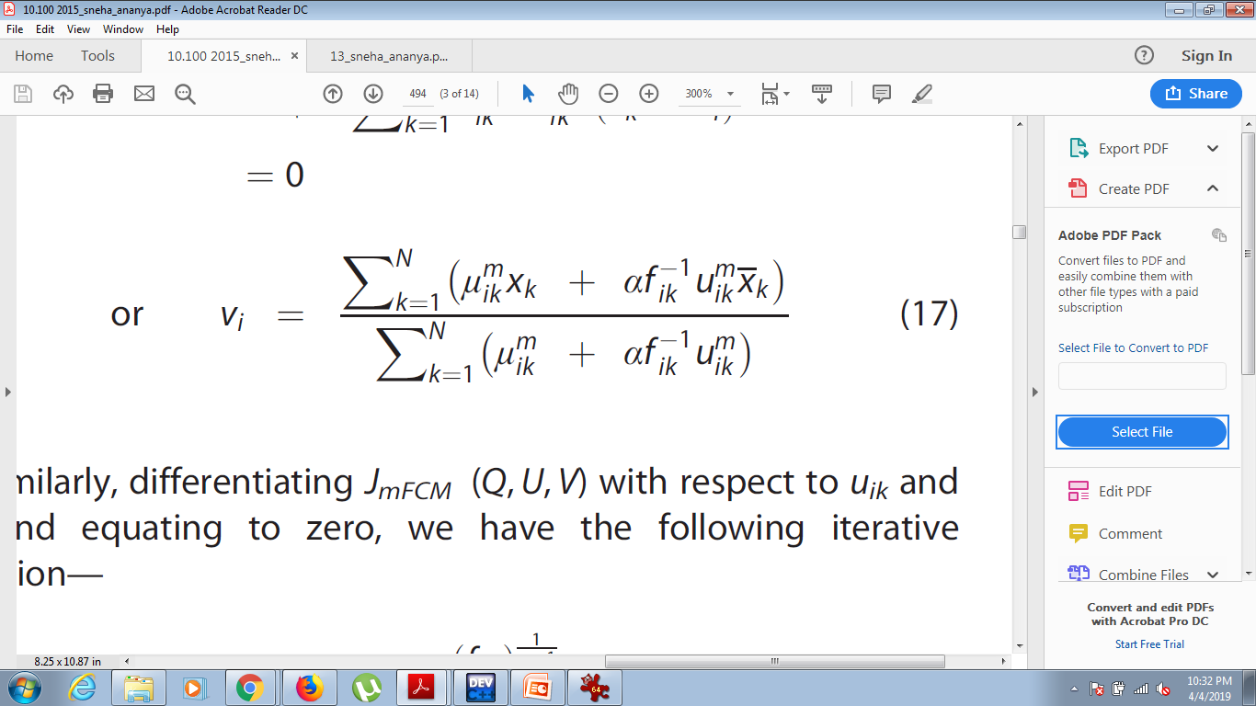
Global membership values :
Local membership values :
Joint membership values :
Cluster centers :
Final cluster centers :

Slide 13
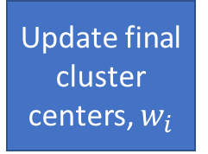
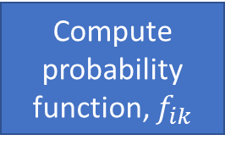

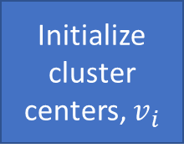
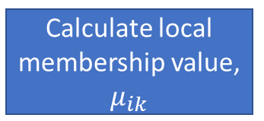

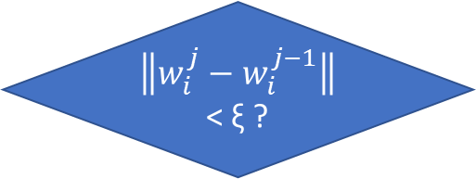
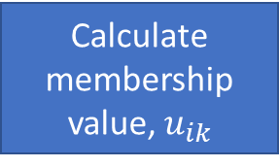
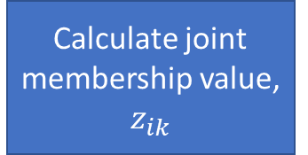
Input image
Initialize cluster centers, $v_{i}$
Set j = 0
Start
Initialise final cluster centers, $w_{i}$
Compute probability function, $f_{ik}$
Calculate membership value, $u_{ik}$
Calculate local membership value, $μ_{ik}$
j = j + 1
No
Calculate joint membership value, $z_{ik}$
Update final cluster centers, $w_{i}$
Update cluster centers, $v_{i}$
$\left\|w_{i}^{j}−w_{i}^{j−1}\right\|$<ξ ?
Yes
Stop
Output
Image
Final Image
Segmentation

Slide 14

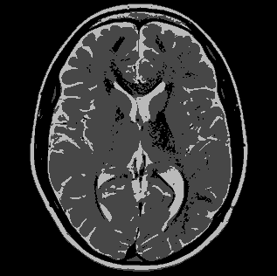
Result
Original Image
Image segmented using mFCM

Slide 15
spacially constrained kernelized Fuzzy C – Means (skFCM)

Slide 16
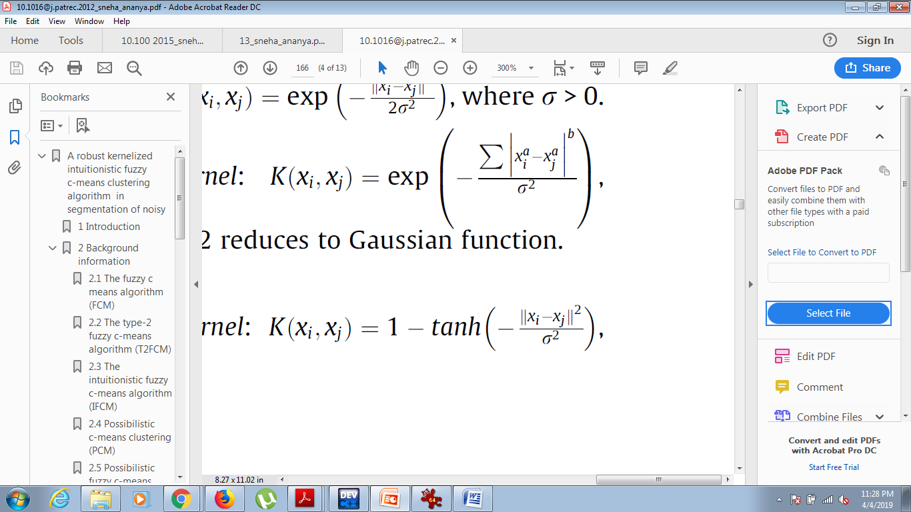
Kernel Functions
Polynomial Kernel :
Gaussian Kernel :
Radial Basis Kernel :
Hyper Tangent Kernel :

Slide 17
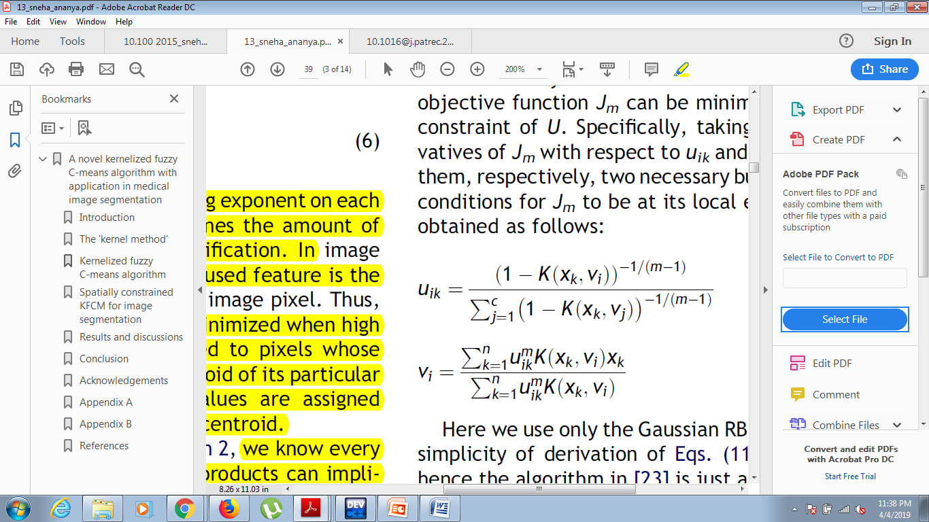
Membership values :
Cluster Centers :

Slide 18
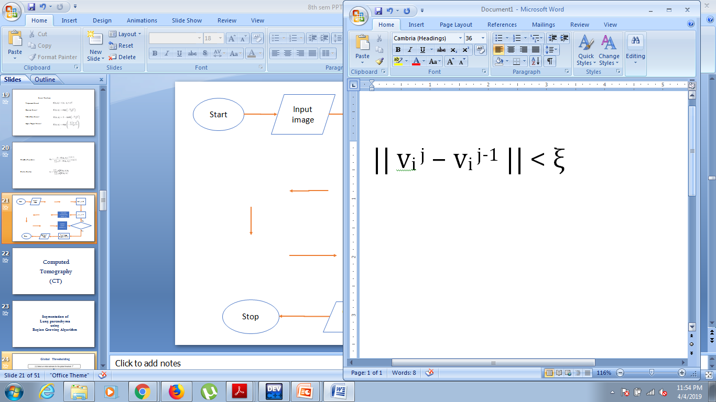
Start
Input image
Initialize cluster centers
Set j = 0
Calculate membership values
j = j + 1
No
Update cluster centers
Yes
Stop
Output
Image
Final Image
Segmentation

Slide 19
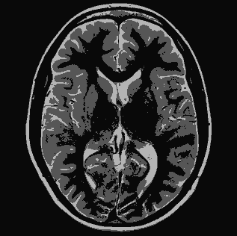
Result
Original Image
Image segmented using skFCM

Slide 20
Comparison
Image segmented using mFCM
Original Image
Image segmented using skFCM

Slide 21

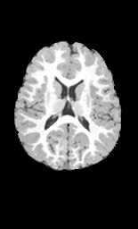

Comparison
Image segmented using mFCM
Original Image
Image segmented using skFCM

Slide 22
ULTRASONOGRAPHY

Slide 23
Speckle Noise
Speckle is a granular 'noise' that inherently exists in and degrades the quality of the medical ultrasound images.

Slide 24
Kuan Filter
It is local linear minimum mean square error filter under multiplicative noise.
It has no approximation involved and transforms the multiplicative speckle model into the additive linear form.

Slide 25
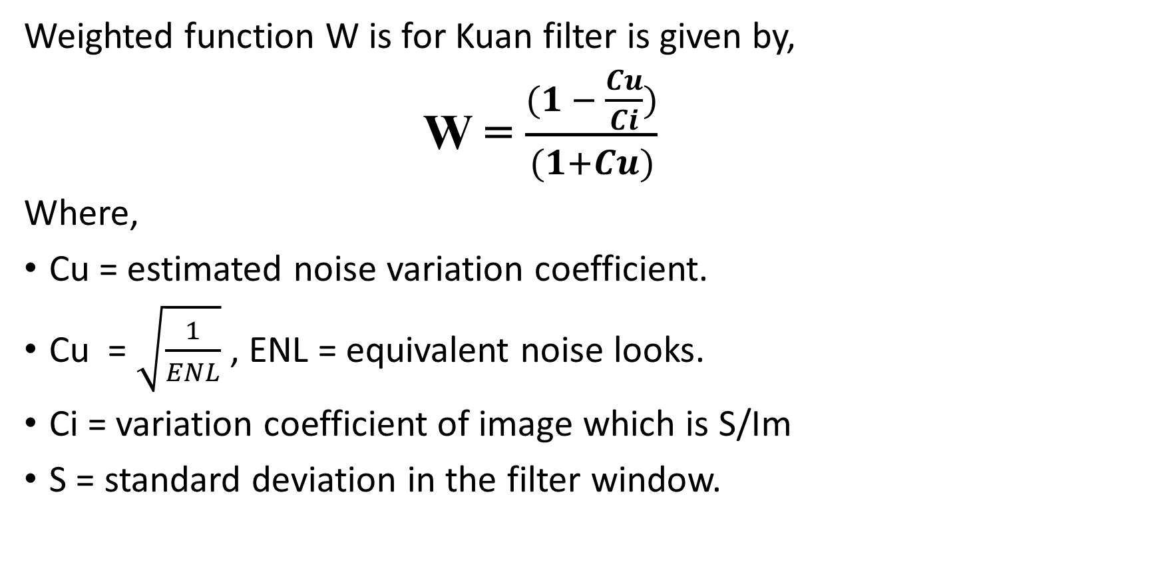
Weighted function W is for Kuan filter is given by,
W = $\frac{(1 − \frac{Cu}{Ci})}{(1+Cu)}$
Where,
Cu = estimated noise variation coefficient.
Cu = $\sqrt{\frac{1}{ENL}}$ , ENL = equivalent noise looks.
Ci = variation coefficient of image which is S/Im
S = standard deviation in the filter window.

Slide 26
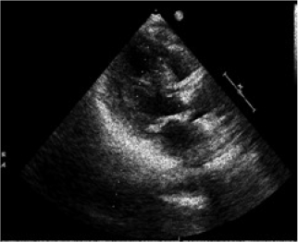
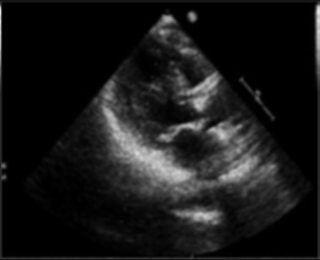
Experimental Results
Noisy Ultrasound Image
Noise Reduced Ultrasound Image

Slide 27
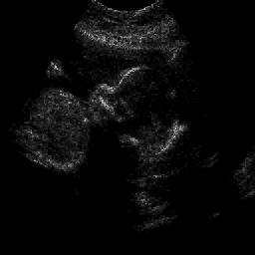

Experimental Results
Noisy Ultrasound Image
Noise Reduced Ultrasound Image

Slide 28
Speckle Smoothing Algorithm With Edge Preservation
Based on local order statistics to remove speckle noise with edge preservation capabilities.
Combines Sigma Filter with High Pass Filter.

Slide 29
Sigma Filter
Compute Variance and Mean of the 3*3 window s(m, n).
Compute lower and upper intensity values as:
cl = mean(s(m, n)) – 3* mean(s(m, n))*var(s(m, n))
cu = mean(s(m, n)) + 3* mean(s(m, n))*var(s(m, n))
Intensity of each pixel is compared with cl and cu, if it lies in the limits then it is replaced by the mean of the pixels that lie between cl and cu.

Slide 30

Experimental Results
Noisy Ultrasound Image
Noise Reduced Ultrasound Image

Slide 31

Experimental Results
Noisy Ultrasound Image
Noise Reduced Ultrasound Image

Slide 32
Conclusion
We have implemented different algorithms on various types of medical images and obtained the required experimental results.
For the completion of the project, we aim to compare these different types of methods with different parameters to understand which method is the most suitable for a particular type of medical image.

